Slide 1
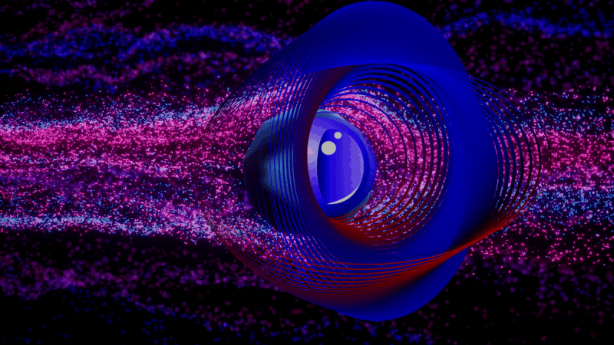
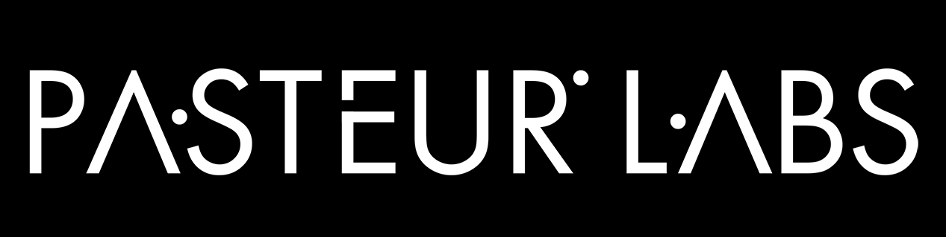
Tap into the source code of reality
Physics-Informed AI for Real-World Engineering
Nikolas Borrel-Jensen, Simulation Intelligence Engineer
D3A, Nyborg, Denmark, October 8, 2026
Not for redistribution without express permission of Pasteur Labs designated representatives.

Slide 2

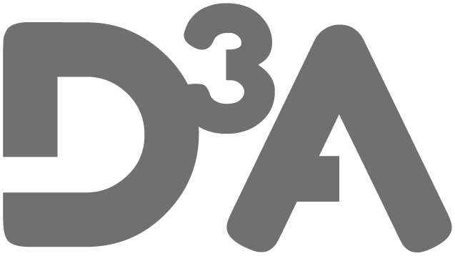

Program – D3A, Nyborg, Denmark, October 8, 2026
Thursday 8 October 11.00
11:10 - 11:20 Landscape framing (Nikolas Borrel-Jensen)
11:20 - 11:40 2 lightning talk (Niels Skovgaard Jensen and Jakob Tanderup)
11:40 - 12:10 Live tutorial (Dion Haefner)
12:10 - 12:30 Structured discussion (Allan P. Engsig-Karup)
GitHub repo

Slide 3
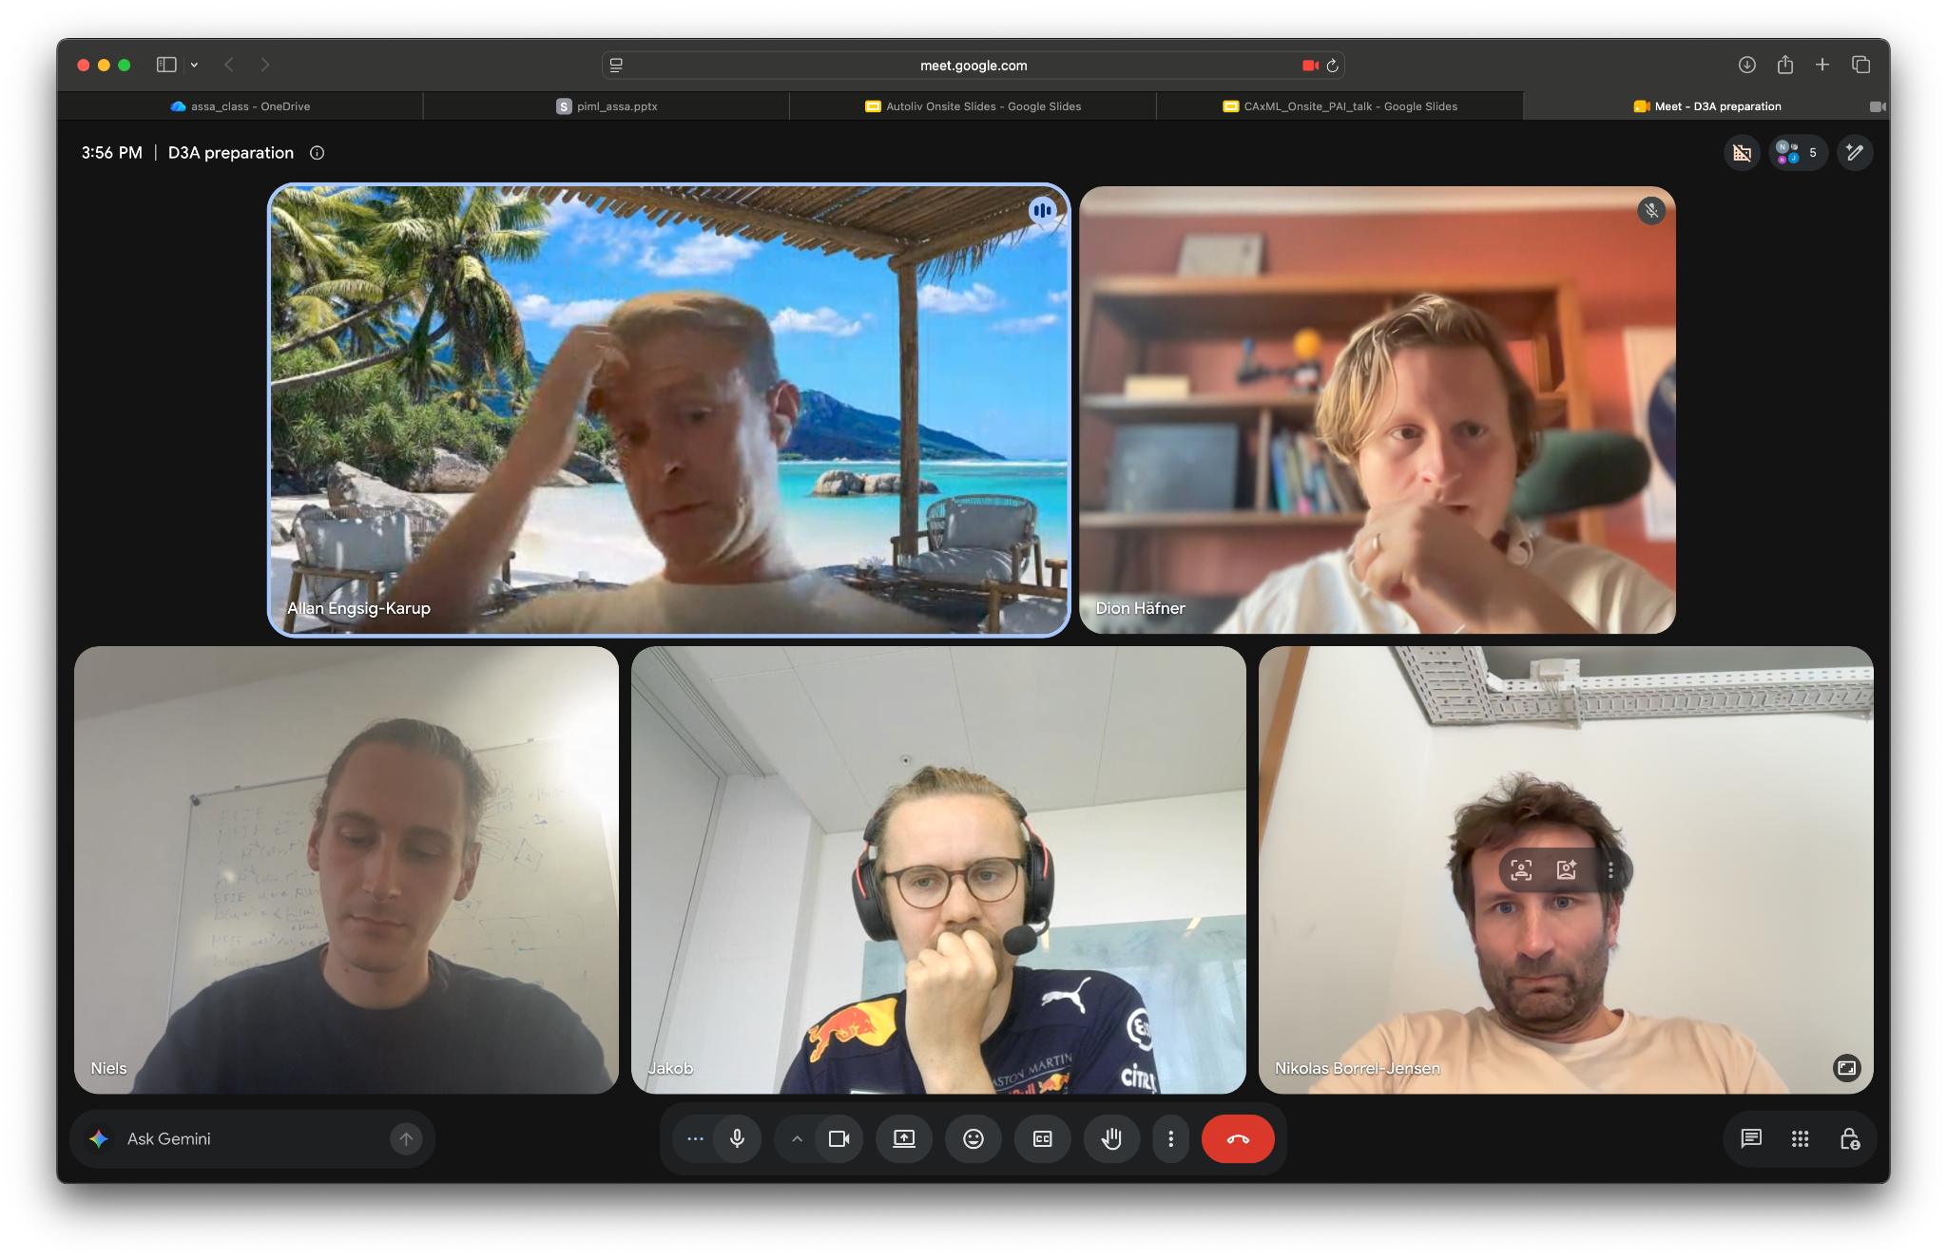
Organizers

Slide 4
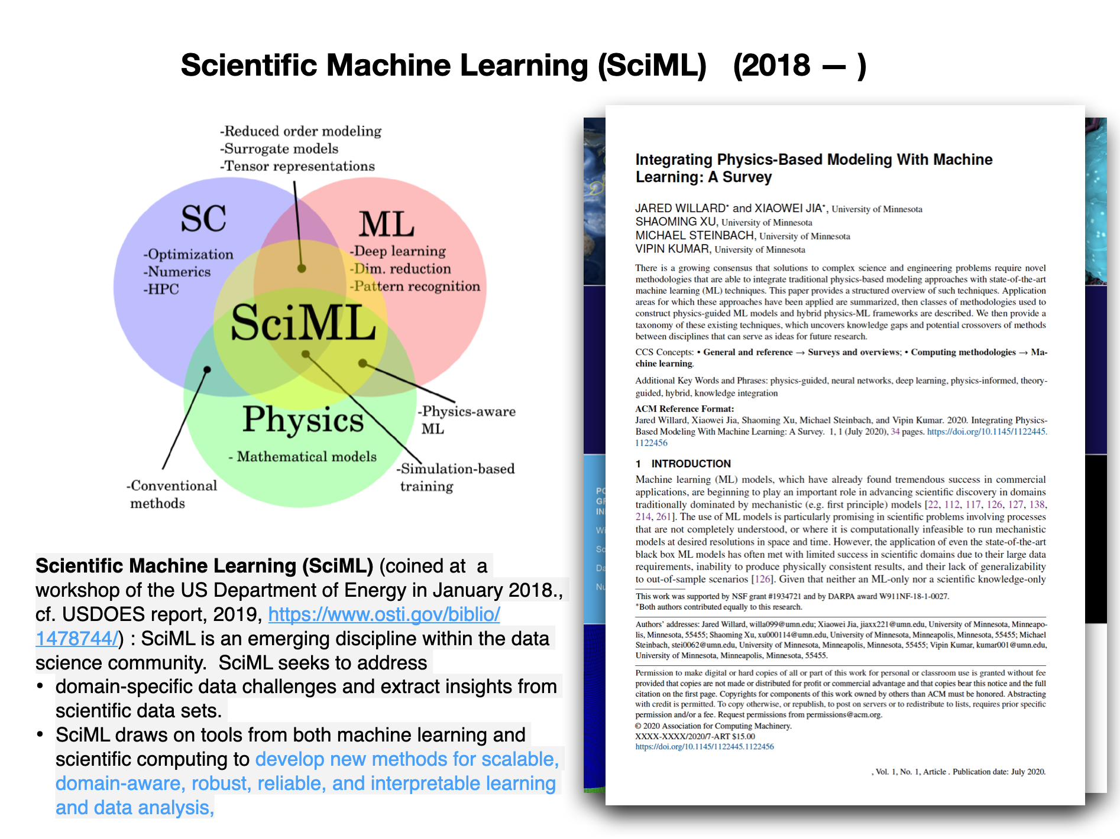
Physics-Informed AI for Real-World Engineering: a slice through the landscape in 10 minutes

Slide 5
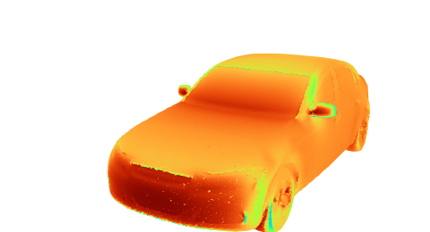
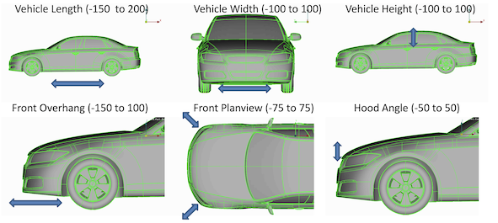
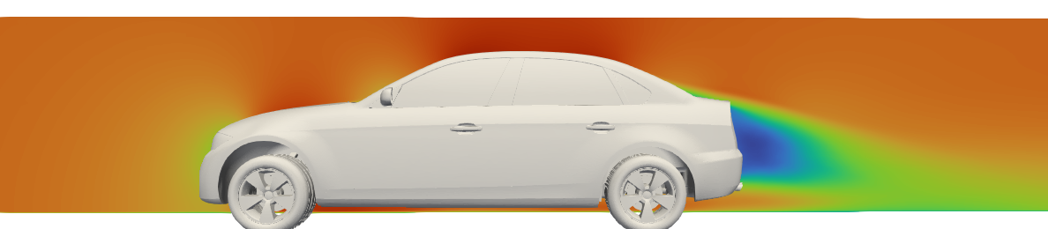
Designing a car's shape: what does the aerodynamicist need to know?
surface pressure
streamwise velocity on the symmetry plane
How much drag? Drag coefficient C_d → range and energy use
Is the lift balanced? Lift C_l and pitching moment C_m → front/rear axle load, high-speed stability
Where do the forces come from? Surface pressure C_p and the flow around the car → where the flow separates, and where to change the shape
Notes:
C_d is how hard the air pushes the car back, C_l how hard it lifts it, and C_m how it shares that lift between the front and rear wheels.

Slide 6
One CFD run takes hours, and a design loop needs 1000s of them.
Edit setup
Generate more data
Setup
Simulation
V&V
Data Generation
SciML
Optimization
Geometry,
Mesh,
BCs
Multi-physics
solvers
Post-processing, Visualization,
Anomaly detection
DOE,
Parameter sweeps
Surrogate
modeling
Gradient-based,
BO,
UQ
Two ways to get speed, and gradients:
 | Neural surrogate | Differentiable solver
Idea | Learn the map design → fields from simulation data | Make the solver itself a program that gradients flow through
Cost | Expensive offline (data + training), ms at inference | Cost of a solve, plus a backward pass
Trust | Approximate: errors from data coverage, architecture and training; no built-in error estimate | Physics exact up to discretization
Today | This talk! | Lightning talk 1 (Niels), tutorial
Notes:
C_d is how hard the air pushes the car back, C_l how hard it lifts it, and C_m how it shares that lift between the front and rear wheels.

Slide 7
Where does the physics go?
The PINN loss as the example:
 | Constrained | Penalized/informed | Architecture
How | Forced to satisfy the physical model | Physics as a penalty in the loss | Physical properties built into the model
Example | Impose known solutions of the governing equation (e.g. hard BCs) | Add the governing equation; small deviations allowed (PINNs) | Encode general properties: symmetry, locality, conservation, multiscale
Strictness | Exact | Soft | Structural
→ PINNs in practice: Lightning talk 2 (Jakob)
→ The rest of this talk: the architecture column

Slide 8

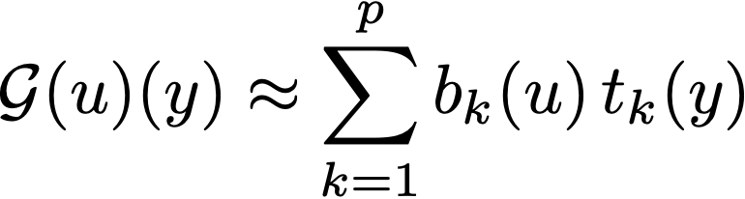
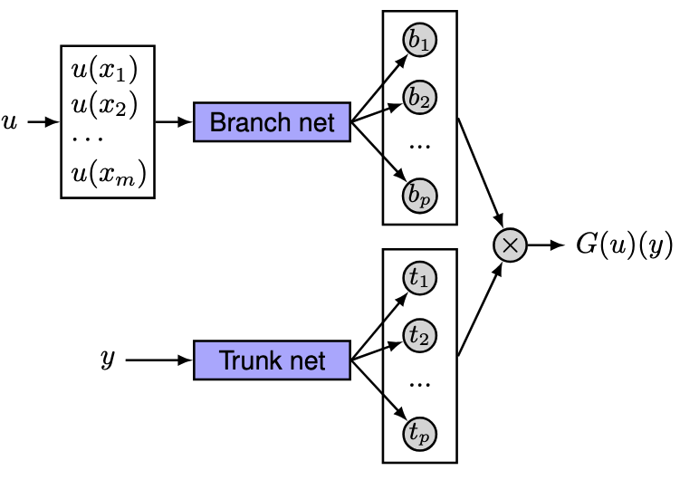
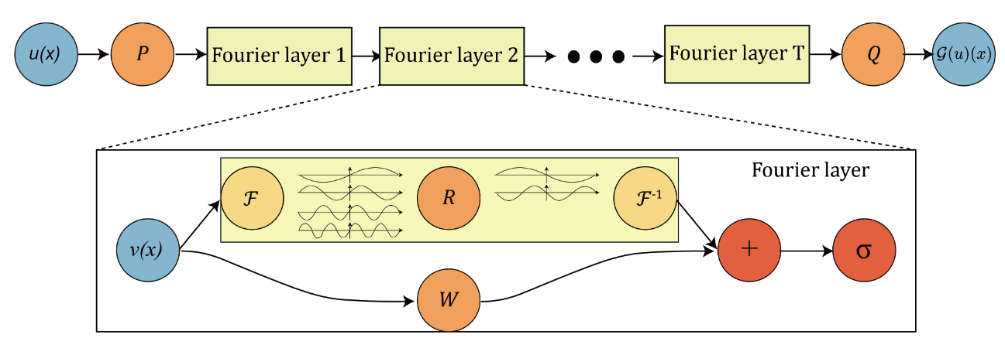
From learning a solution to learning the solver
Learn the operator (coefficients, BCs, geometry → solution field), independently of the discretization.
Fourier Neural Operator (FNO) | DeepONet
Global convolution in Fourier space, truncated to low modes | Global convolution in Fourier space, truncated to low modes
Fast on regular grids | Arbitrary query points
Needs a grid; struggles with complex geometry | Basis is global, not adapted to the geometry
Notes:
Start from input u. 1. Lift to a higher dimension channel space by a neural network P. 2. Apply four layers of integral operators and activation functions. 3. Project back to the target dimension by a neural network Q. Output G(u).
Fourier layers: Start from input v. On top: apply the Fourier transform F; a linear transform R on the lower Fourier modes and filters out the higher modes; then apply the inverse Fourier transform F −1. On the bottom: apply a local linear transform W .

Slide 9
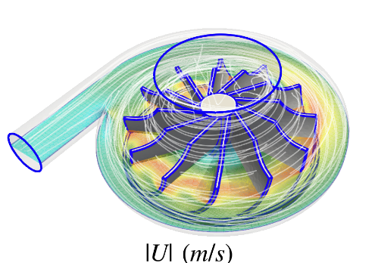
What industrial CAE actually looks like
Steady (BVP): the boundary shapes the whole domain → global reach in one forward pass
Evolution (IVP/IBVP): march from an initial state → stable long rollouts
Multiphysics: coupled fields across scales and solvers → information across interfaces
→ Unstructured meshes of 10⁵–10⁸ cells, and hundreds of samples (not millions)
Centrifugal pump
300 samples
~269MB, 1.4M cells, ~80 GB in total
Car aero dynamics (DrivAerML dataset)
500 samples
~0.6 GB, ~9M points/~45 GB, ~160M cells, ~31 TB in total
Ashton et al. (arXiv:2408.11969)

Slide 10
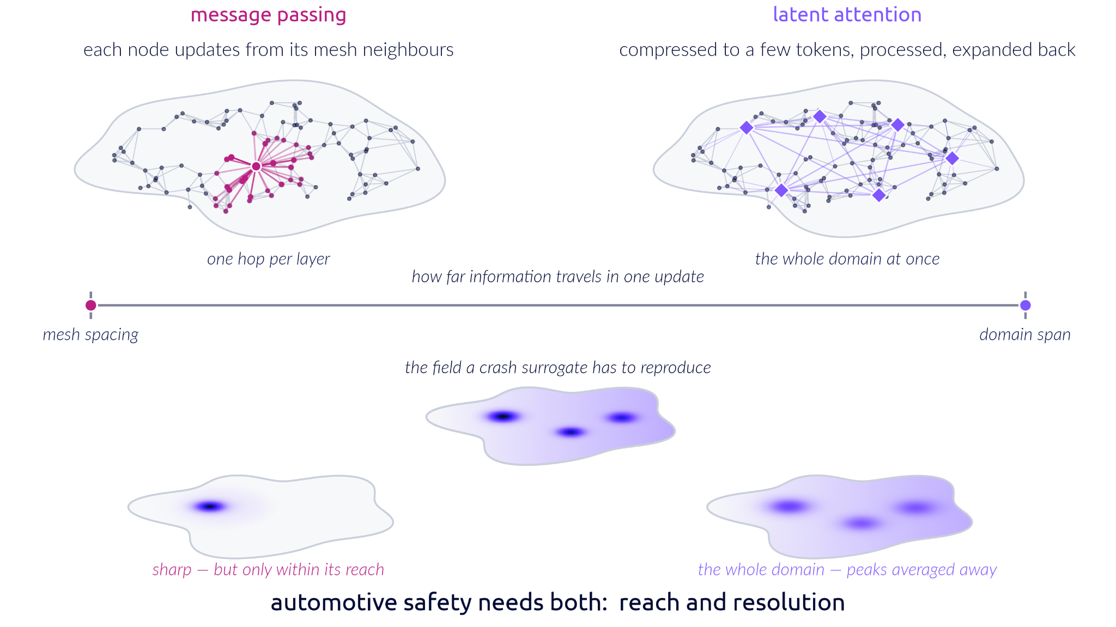
Graph networks see the neighbours, transformers see the big picture
Local: MeshGraphNet (MGN) | Global: latent-token transformers
Mesh = graph; message passing along edges | Compress N mesh points into L ≪ N latent tokens, process them, write back
Physics in the architecture: locality, permutation invariance, relative coordinates (a learned stencil) | Transolver, Perceiver/UPT, Surya
✔ Sharp local detail | ✔ Global reach in one layer
✘ Information moves one hop per layer | ✘ Behaves like a low-pass filter: smooths fine scales

Slide 11
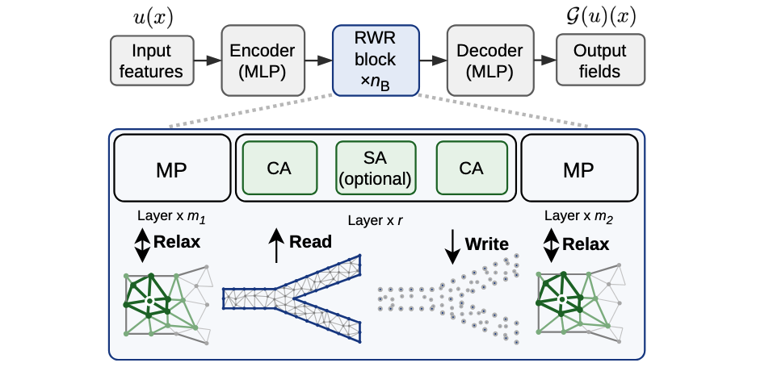
Read-Write-Relax (RWR), a neural PDE surrogate with local AND global processing
RWR interleaves local and global processors similar to a multigrid cycle: one correcting low-frequency error, the other high-frequency error.
the field a surrogate has to produce
message passing sees
latent attention returns
sharp, but only within its reach
the whole domain, but peaks averaged away
Kumar, Zimmermann, Bjorgaard, Chaplais, Bouklas, Salvador, Lavin (arXiv:2608.21677)
Notes:
RWR interleaves latent attention with message-passing relaxation under a unified configuration.
The encoder and decoder are pointwise MLPs; the processor runs m1 message-passing sweeps (relax), r read-write iterations against L persistent latent tokens, and m2 further sweeps; nB such blocks are stacked.
By interleaving blocks of message passing and latent attention repeatedly, it allows opportunity for information to propagate over the entire mesh while also appropriately resolving it at the desired accuracy.

Slide 12
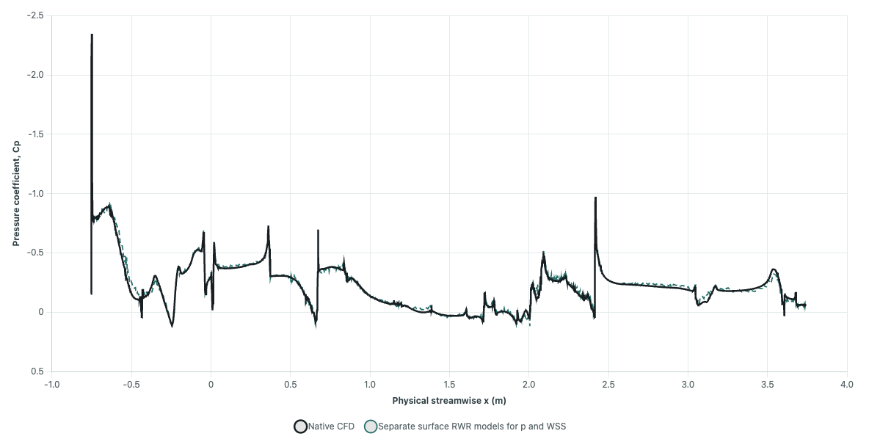
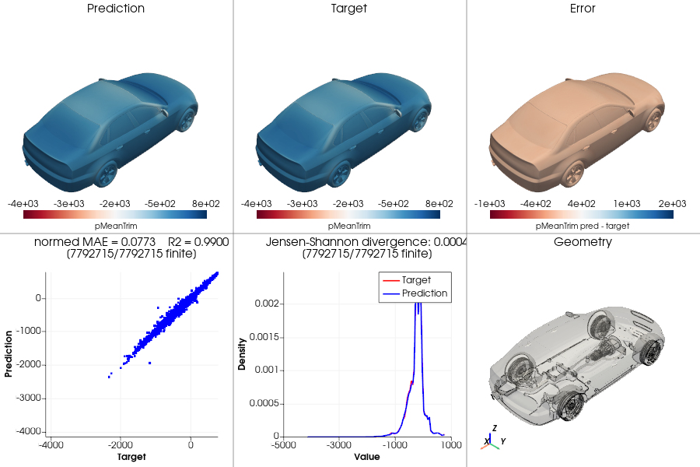
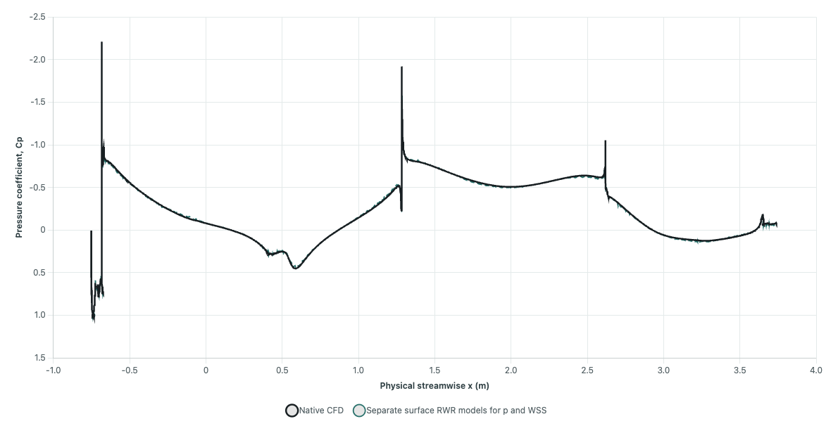
Can a surrogate stand in for CFD in a car-aero design loop?
The Read-Write-Relax (RWR) surrogate was trained on the DrivAerML dataset containing ~500 morphed variants of the DrivAer car (Ashton et al. 2024)
 | Question | Why it matters
Fields | Are the surface fields right everywhere? | Surface pressure produces most of the force
Profiles | Is C_{p} right along body sections? | Comparable with wind-tunnel probes
Forces | Do C_{d}, C_{l}, C_{m} follow design changes car to car? | Drag → range; lift balance → handling
Notes:
C_d is how hard the air pushes the car back, C_l how hard it lifts it, and C_m how it shares that lift between the front and rear wheels.

Slide 13
Takeaways
Physics can go into the loss, the constraints, or the architecture (the architecture route scales best)
Neural operators learn solvers, not solutions
Both global reach and local resolution are needed on real-world meshes
Validate on what engineers care about: forces, profiles, not bulk error alone.
Many successful SciML methods are inspired by what made solvers great (RWR = multigrid-inspired)
Next in this session:
⚡Differentiable electromagnetics, learning inside the solver (Niels)
⚡Sensing with PINNs, the loss route (Jakob)

